Slide 1
FRB Update #5
William Huang
(6/28/2020)

Slide 2
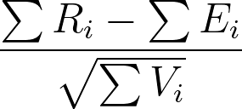
First Implementation of Kendall Tau
Using the following formula, with
R_i = relative luminosity rank of data point i in within the luminosity associated set
E_i = 0.5
V_i = 1/12
With E_i and V_i values corresponding to the expectation and variance of a uniform distribution.

Slide 3
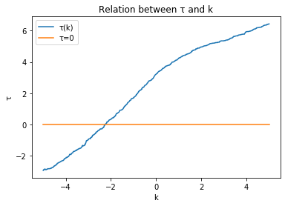
L_p versus z.
I first implemented Kendall tau in L_p versus z, using g(z) above.
Found a value of k≈ -2 to correspond with tau=0.

Slide 4
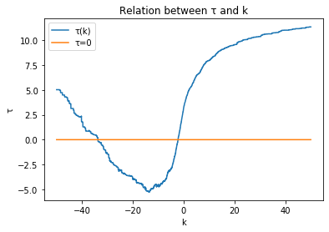
Multiple k such that tau=0
I also found that at much larger negative values of k, tau also reached zero at around k = -35. I’m not sure if that should happen.

Slide 5
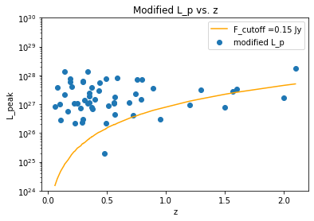

(cont.)
My theory is that in my calculation, I use the same flux cutoff as the cutoff, even for different values of k. This causes some of the data points to automatically obtain a relative rank of 1/N. As seen in the graph in the right, this is a plot of
Should the cutoff flux be adjusted for different values of k?

Slide 6
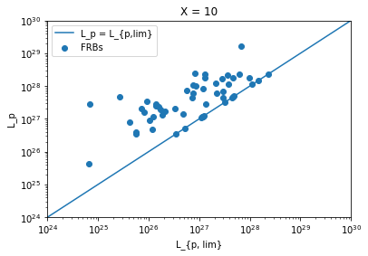
General Steps Moving Forward
In the case of L_p versus L_{p, lim}, like the graph shown on the right using X=10 and (S/N - X), should the cutoff line simply be L_p = L_{p,lim}?
In general, should the cutoff line be picked such that it actually removes a few data points?

